Slide 1
Stacks
Chapter 6

Slide 2
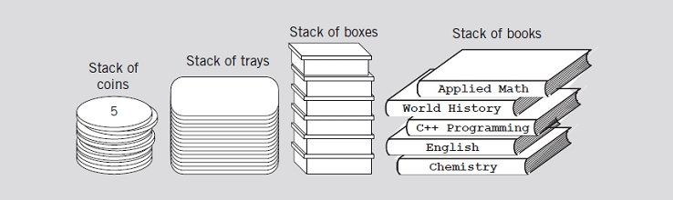
Stack
A Stack is a data structure in which data is added and removed at only one end called the top.
To add (push) an item to the stack, it must be placed on the top of the stack.
To remove (pop) an item from the stack, it must be removed from the top of the stack too.
Thus, the last element that is pushed into the stack, is the first element to be popped out of the stack. i.e., Last In First Out (LIFO)
Notes:
Internet Web browsers store the addresses of recently visited sites on a stack. Each time a user visits a new site, that site’s address is “pushed” onto the
stack of addresses. The browser then allows the user to “pop” back to previously visited sites using the “back” button.

Slide 3
Stack
Many applications:
Internet Web browsers (back button).
Text editors usually (undo mechanism)
Chain of method calls in the Java Virtual Machine
Evaluating postfix expressions

Slide 4
Stack ADT
push(e): Adds element e to the top of the stack.
pop( ): Removes and returns the top element from the stack (or null if the stack is empty).
top( ): Returns the top element of the stack, without removing it (or null if the stack is empty).
size( ): Returns the number of elements in the stack.
isEmpty( ): Returns a boolean indicating whether the stack is empty.

Slide 5
Stack Operations
Stack operations are:
Push -> inserts an element on to top of stack
Pop -> deletes an element from the top of the stack

Slide 6
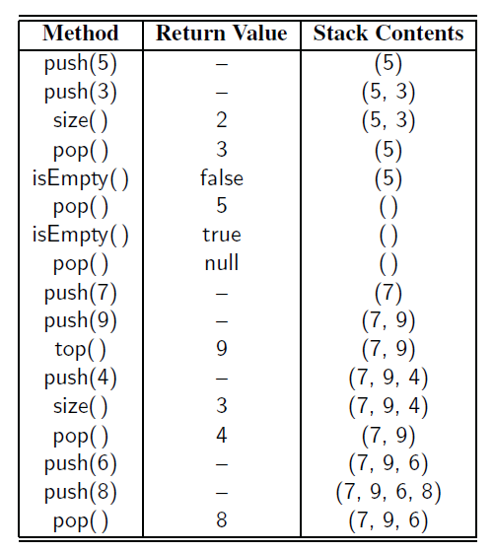
Example
Assume S is an empty stack of integers:

Slide 7
Stack Interface
public interface Stack<E> {
int size( );
boolean isEmpty( );
void push(E e);
E top( );
E pop( );
}

Slide 8
Stack Implementation
Array-based implementation
Linked-list-based implementation

Slide 9
Array-Based Stack Implementation
Store elements in an array, data, with capacity N for some fixed N.
The bottom element of the stack is always stored in cell data[0]
The top element of the stack in cell data[t]
The top element of the stack in cell data[t]
t= size of the stack -1
when the stack is empty, t = −1
Array Capacity vs Stack size
Position of Top (t) | Status of Stack
-1 | Stack is Empty
0 | Only one element in Stack
N-1 | Stack is Full
N | Overflow state of Stack

Slide 10
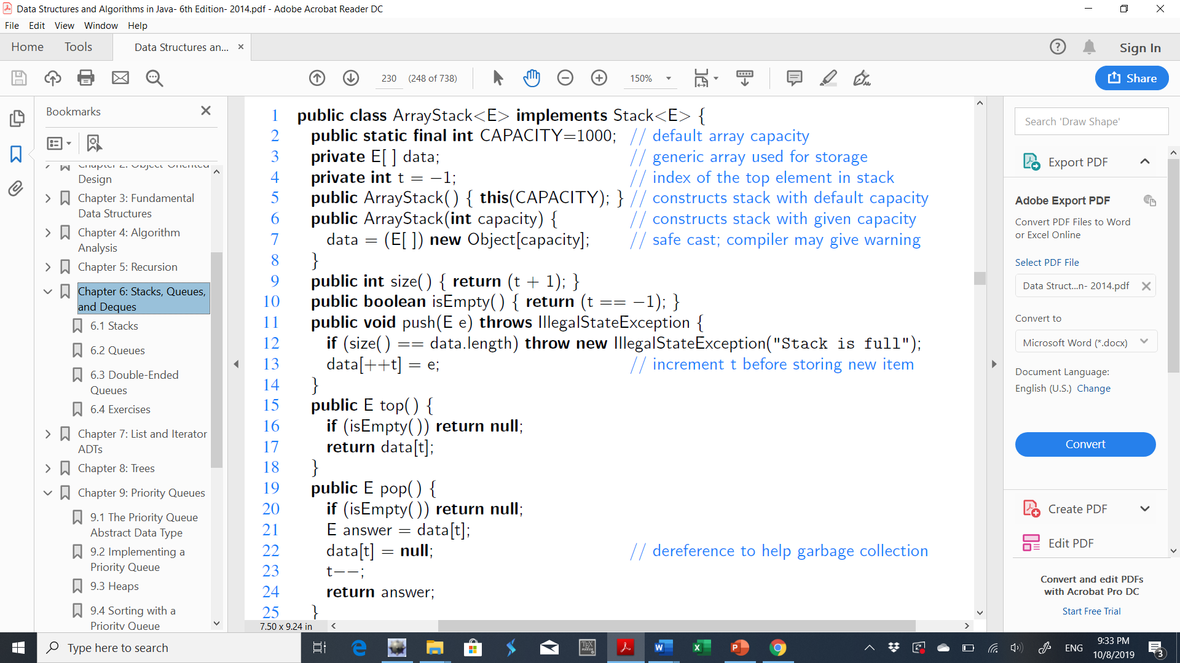
Array-Based Stack Implementation

Slide 11
Array-Based Stack Implementation
CAPACITY 1000
999
.
.
.
.
.
.
1
0
data
t

Slide 12
Array-Based Stack Implementation
999
.
.
.
.
.
. 10
1
0 5
999
.
.
.
.
.
.
1
0
FALSE
TRUE
data
t
t

Slide 13
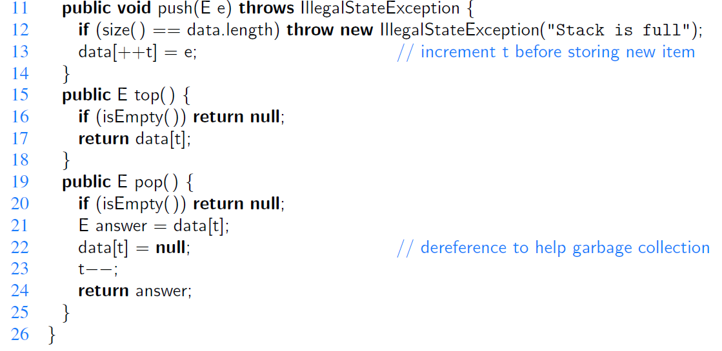
Array-Based Stack Implementation

Slide 14
Using Arrays
First the size has to be defined.
For example: take size of stack is 6
Size of the stack is 6
push(10)
push(-5)
10
-5
10
top
top

Slide 15
Using Arrays
push(100)
size() = 3 Elements
isempty() = False
top() = 100
100
-5
10
top
push(-20)
-20
100
-5
10
top
push(55)
55
-20
100
-5
10
top

Slide 16
Using Arrays
push(25)
size() = 6 Elements
isempty() = False
top() = 25
25
55
-20
100
-5
10
top
push(75)
size() = 6 Elements
isempty() = False
top() = 25
No space is available, this state is called overflow.
25
55
-20
100
-5
10
top
16

Slide 17
Using Arrays
pop()
pop()
pop()
size() = 3 Elements
isempty() = False
top() = 100
55
-20
100
-5
10
-20
100
-5
10
100
-5
10
top
top
top
pop()
pop()
pop()
size() = No Elements
isempty() = True
top() = Error
This state is called underflow.
-5
10
10
top
top

Slide 18
A Drawback of This Array-Based Stack Implementation
Even with its simplicity and efficiency, the array-based stack implementation is not necessarily ideal.
The space usage is O(N),
It relies on a fixed-capacity array, which limits the ultimate size of the stack.
Few elements → west space.
Insert a new element in a full stack → throws an IllegalStateException

Slide 19
Implementing a Stack with a Singly Linked List
Memory usage that is always proportional to the number of actual elements currently in the stack
No capacity limit.
The adapter design pattern applies to any context where we effectively want to modify an existing class so that its methods match those of a related, but different, class or interface.
Define a new class in such a way that it contains an instance of the existing class as a hidden field, and then to implement each method of the new class using methods of this hidden instance variable

Slide 20
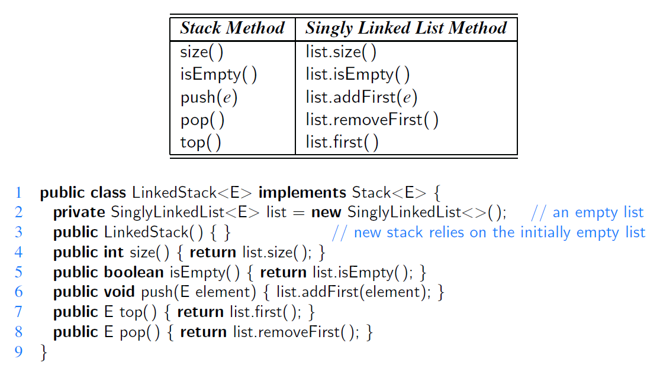
Implementing a Stack with a Singly Linked List

Slide 21
Stack Applications
Check for balancing of parentheses in an expression
Evaluating arithmetic expressions (and other sorts of expression)
Keeping track of previous choices (as in backtracking)
Searching networks, traversing trees (keeping a track where we are).

Slide 22
Matching Parentheses and HTML Tags
Parentheses: “(” and “)”
Braces: “{” and “}”
Brackets: “[” and “]”
In arithmetic expressions, Each opening symbol must match its corresponding closing symbol.
For example, a left bracket, “[,” must match a corresponding right bracket, “],” as in [(5+x) – (y-3)]
Correct: ( )(( )){([( )])}
Correct: ((( )(( )){([( )])}))
Incorrect: )(( )){([( )])}
Incorrect: ({[ ])}
Incorrect:{

Slide 23
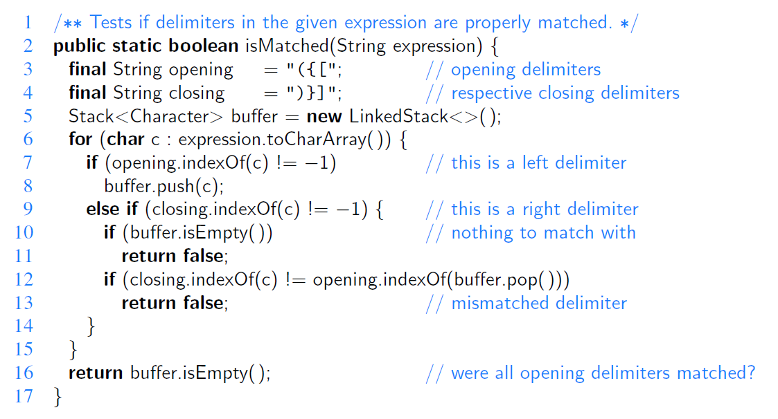
An Algorithm for Matching Delimiters
Notes:
Each time we encounter an opening symbol, we push that symbol onto the stack, and each time we encounter a closing symbol, we pop a symbol from the stack (assuming it is not empty) and check that these two symbols form a valid pair. If we reach the end of the expression and the stack is empty, then the original expression was properly matched. Otherwise, there must be an opening delimiter on the stack without a matching symbol. If the length of the original expression is n, the algorithm will make at most n calls to push and n calls to pop.

Slide 24
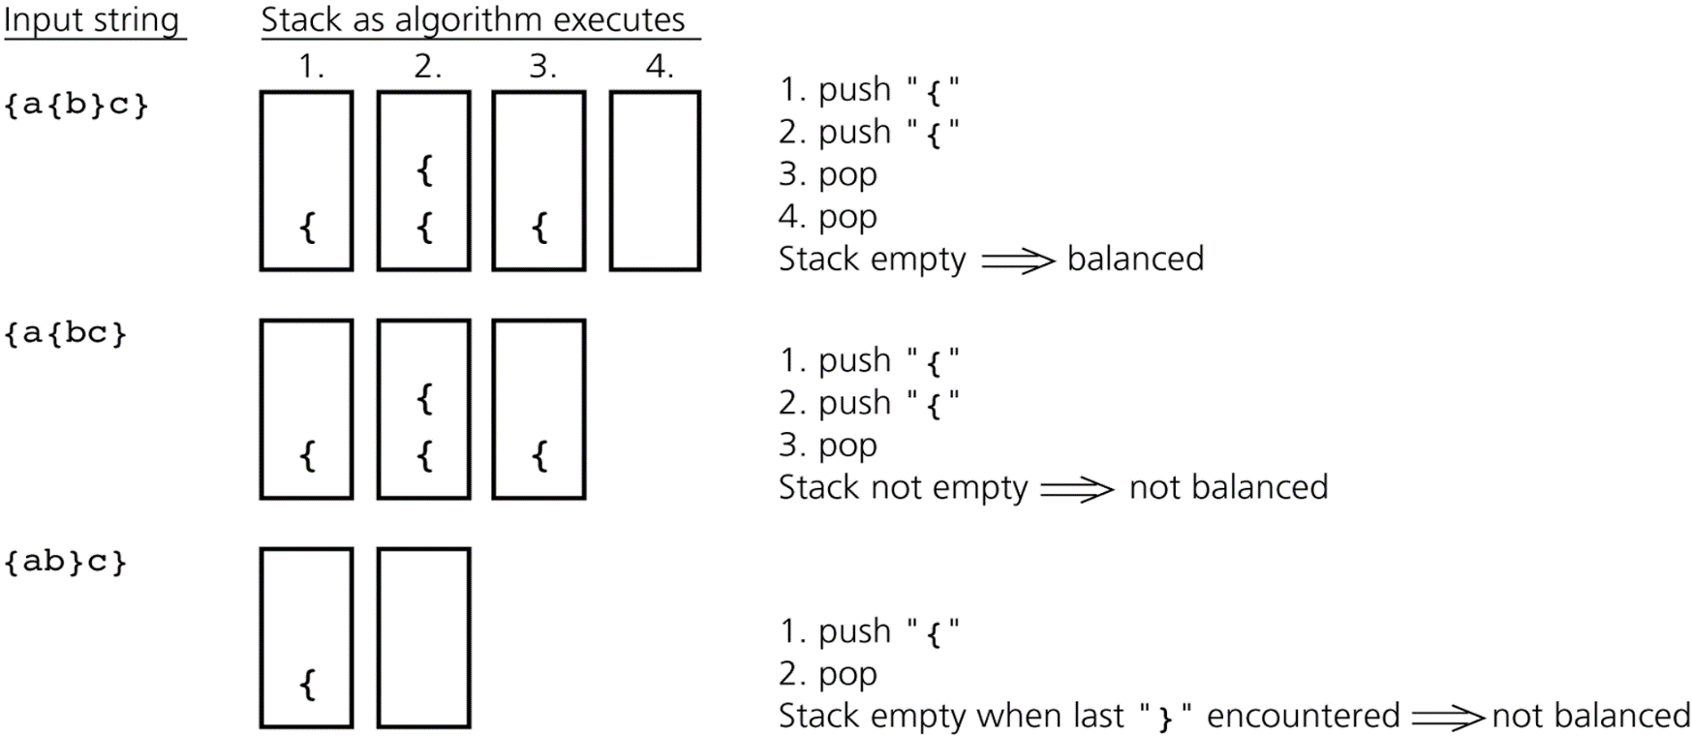
Stack Applications: Check for balanced braces
Requirements for balanced braces
Each time you encounter a “}”, it matches an already encountered “{”
When you reach the end of the string, you have matched each “{”

Slide 25
Stack Applications: Evaluating arithmetic expressions
The stack organization is very effective in evaluating arithmetic expressions.
Expressions are usually represented in Infix notation, in which each operator is written between two operands.
Example: a+b
Parenthesis are used to show the operator precedence
Prefix notation
Operator is placed before its two operands . Parentheses are not required
Example: +ab
Postfix notation
the operator is placed after its two operands. Parentheses are not required
Example: ab+

Slide 26
Stack Applications: Evaluating postfix expressions
The expressions written in postfix form are evaluated faster compared to infix notation as parenthesis are not required in postfix
The compiler scans the expression either from left to right or from right to left.
It is better to convert the expression to postfix(or prefix) form before evaluation
Remember operator precedence
Highest: Exponentiation (^)
Next highest: Multiplication (*) and division (/)
Lowest: Addition (+) and Subtraction (-)

Slide 27
Stack Applications: Convert infix to postfix
Stacks can be used to transform infix mathematics expression to postfix one.
10 + 2 * 8 - 3 ➔ 10 2 8 * + 3 –
Algorithm:
Scan the infix expression from left to right.
If the scanned character is an operand, output it.
If the scanned character is an operator
If its precedence is greater than the precedence of the operator on stack top(or the stack is empty or the stack contains a ‘(‘ ), push it.
else, Pop all the operators from the stack which are greater than or equal to in precedence. Push the scanned operator to the stack. (If you encounter parenthesis while popping then stop there and push the scanned operator in the stack.)
If the scanned character is an ‘(‘, push it to the stack.
If the scanned character is an ‘)’, pop the stack and output it until a ‘(‘ is encountered, and discard both the parenthesis.
Repeat steps 2-6 until infix expression is scanned.
Pop and output from the stack until it is not empty.

Slide 28
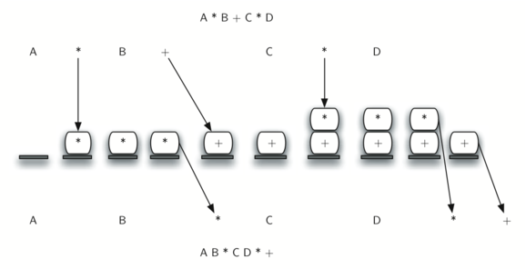
Stack Applications: Convert infix to postfix

Slide 29
Stack Applications: Evaluating postfix expressions
Create a stack to store operands.
When an operand is encountered, push it onto a stack
When an operator is encountered,
Pop second operand
Pop first operand
Evaluate the operator and push the result back to the stack
When the expression is ended, the number in the stack is the final answer

Slide 30
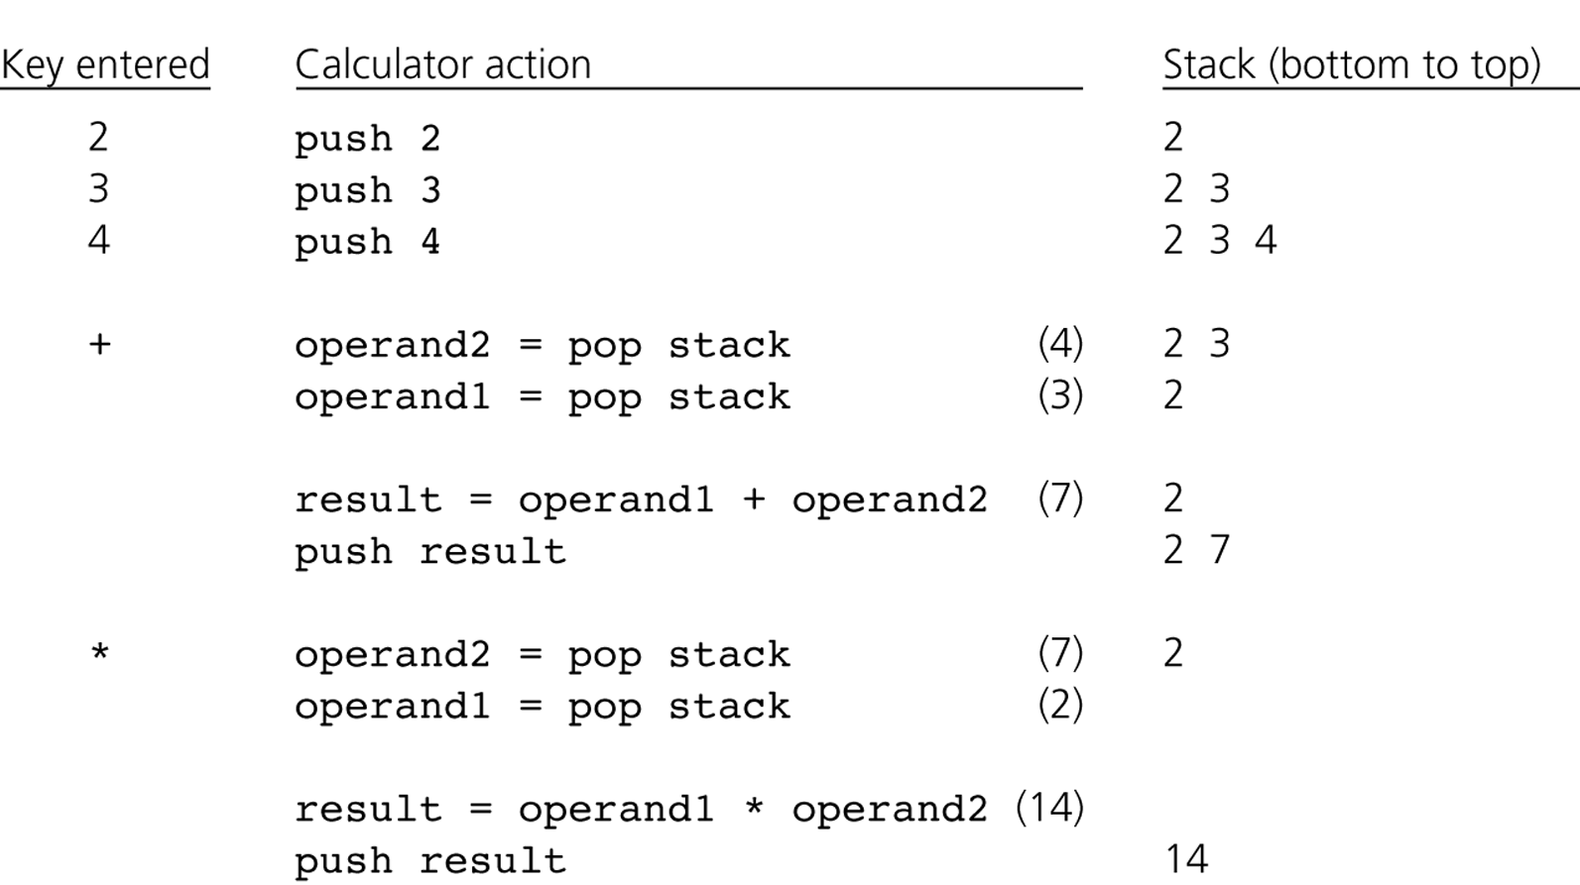
Evaluating postfix expressions (example)

Slide 31
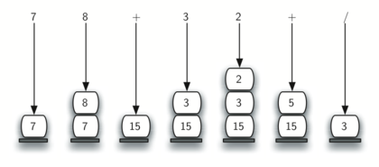
Evaluating postfix expressions (example)
7 8 + 3 2 + /
Note that: for division operation, when the operands are popped from the stack, they are reversed.

